Slide 1
Why Study at KU Leuven
Erasmus+ opportunity for Computer Science students
Jakub Michálek

Slide 2
Contents
Belgium
Leuven
KU Leuven Overview
Computer Science at KU Leuven
Relevant Courses
Advantages for Erasmus Students
Costs & Practical Info
Why KU Leuven

Slide 3
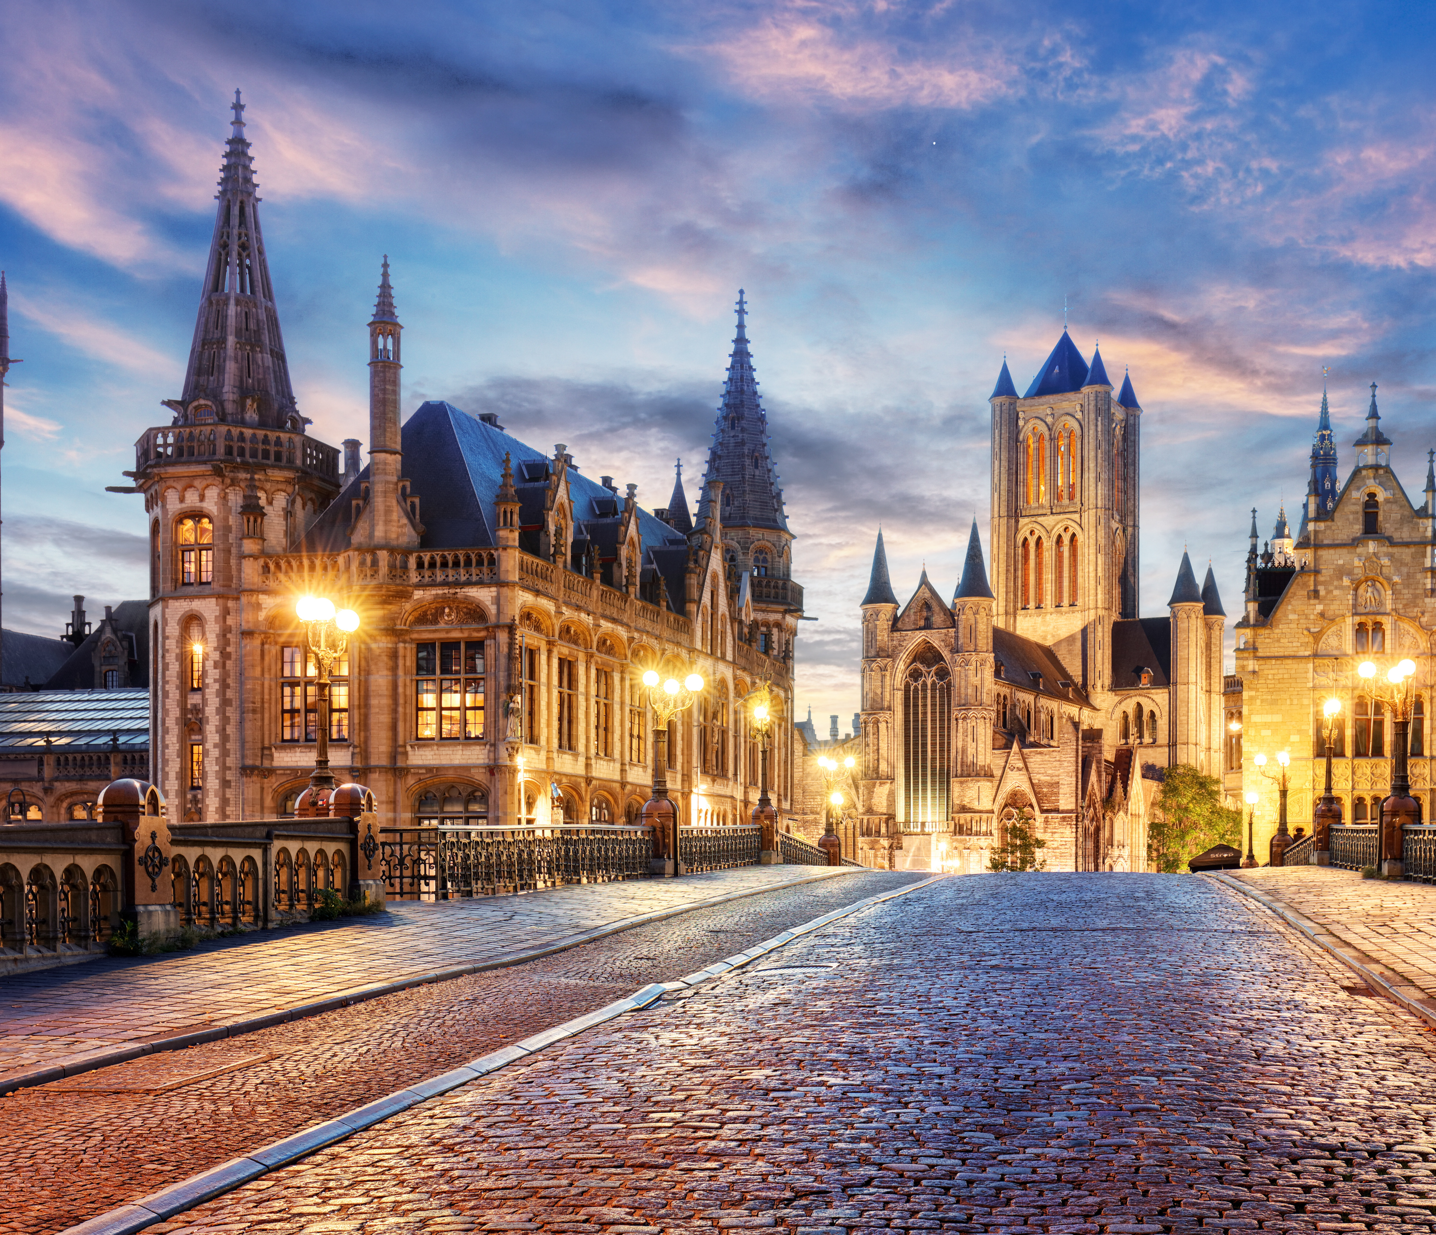
1. Belgium
EU country
Multilingual
High quality of life
Innovative & international
Ghent, Belgium

Slide 4
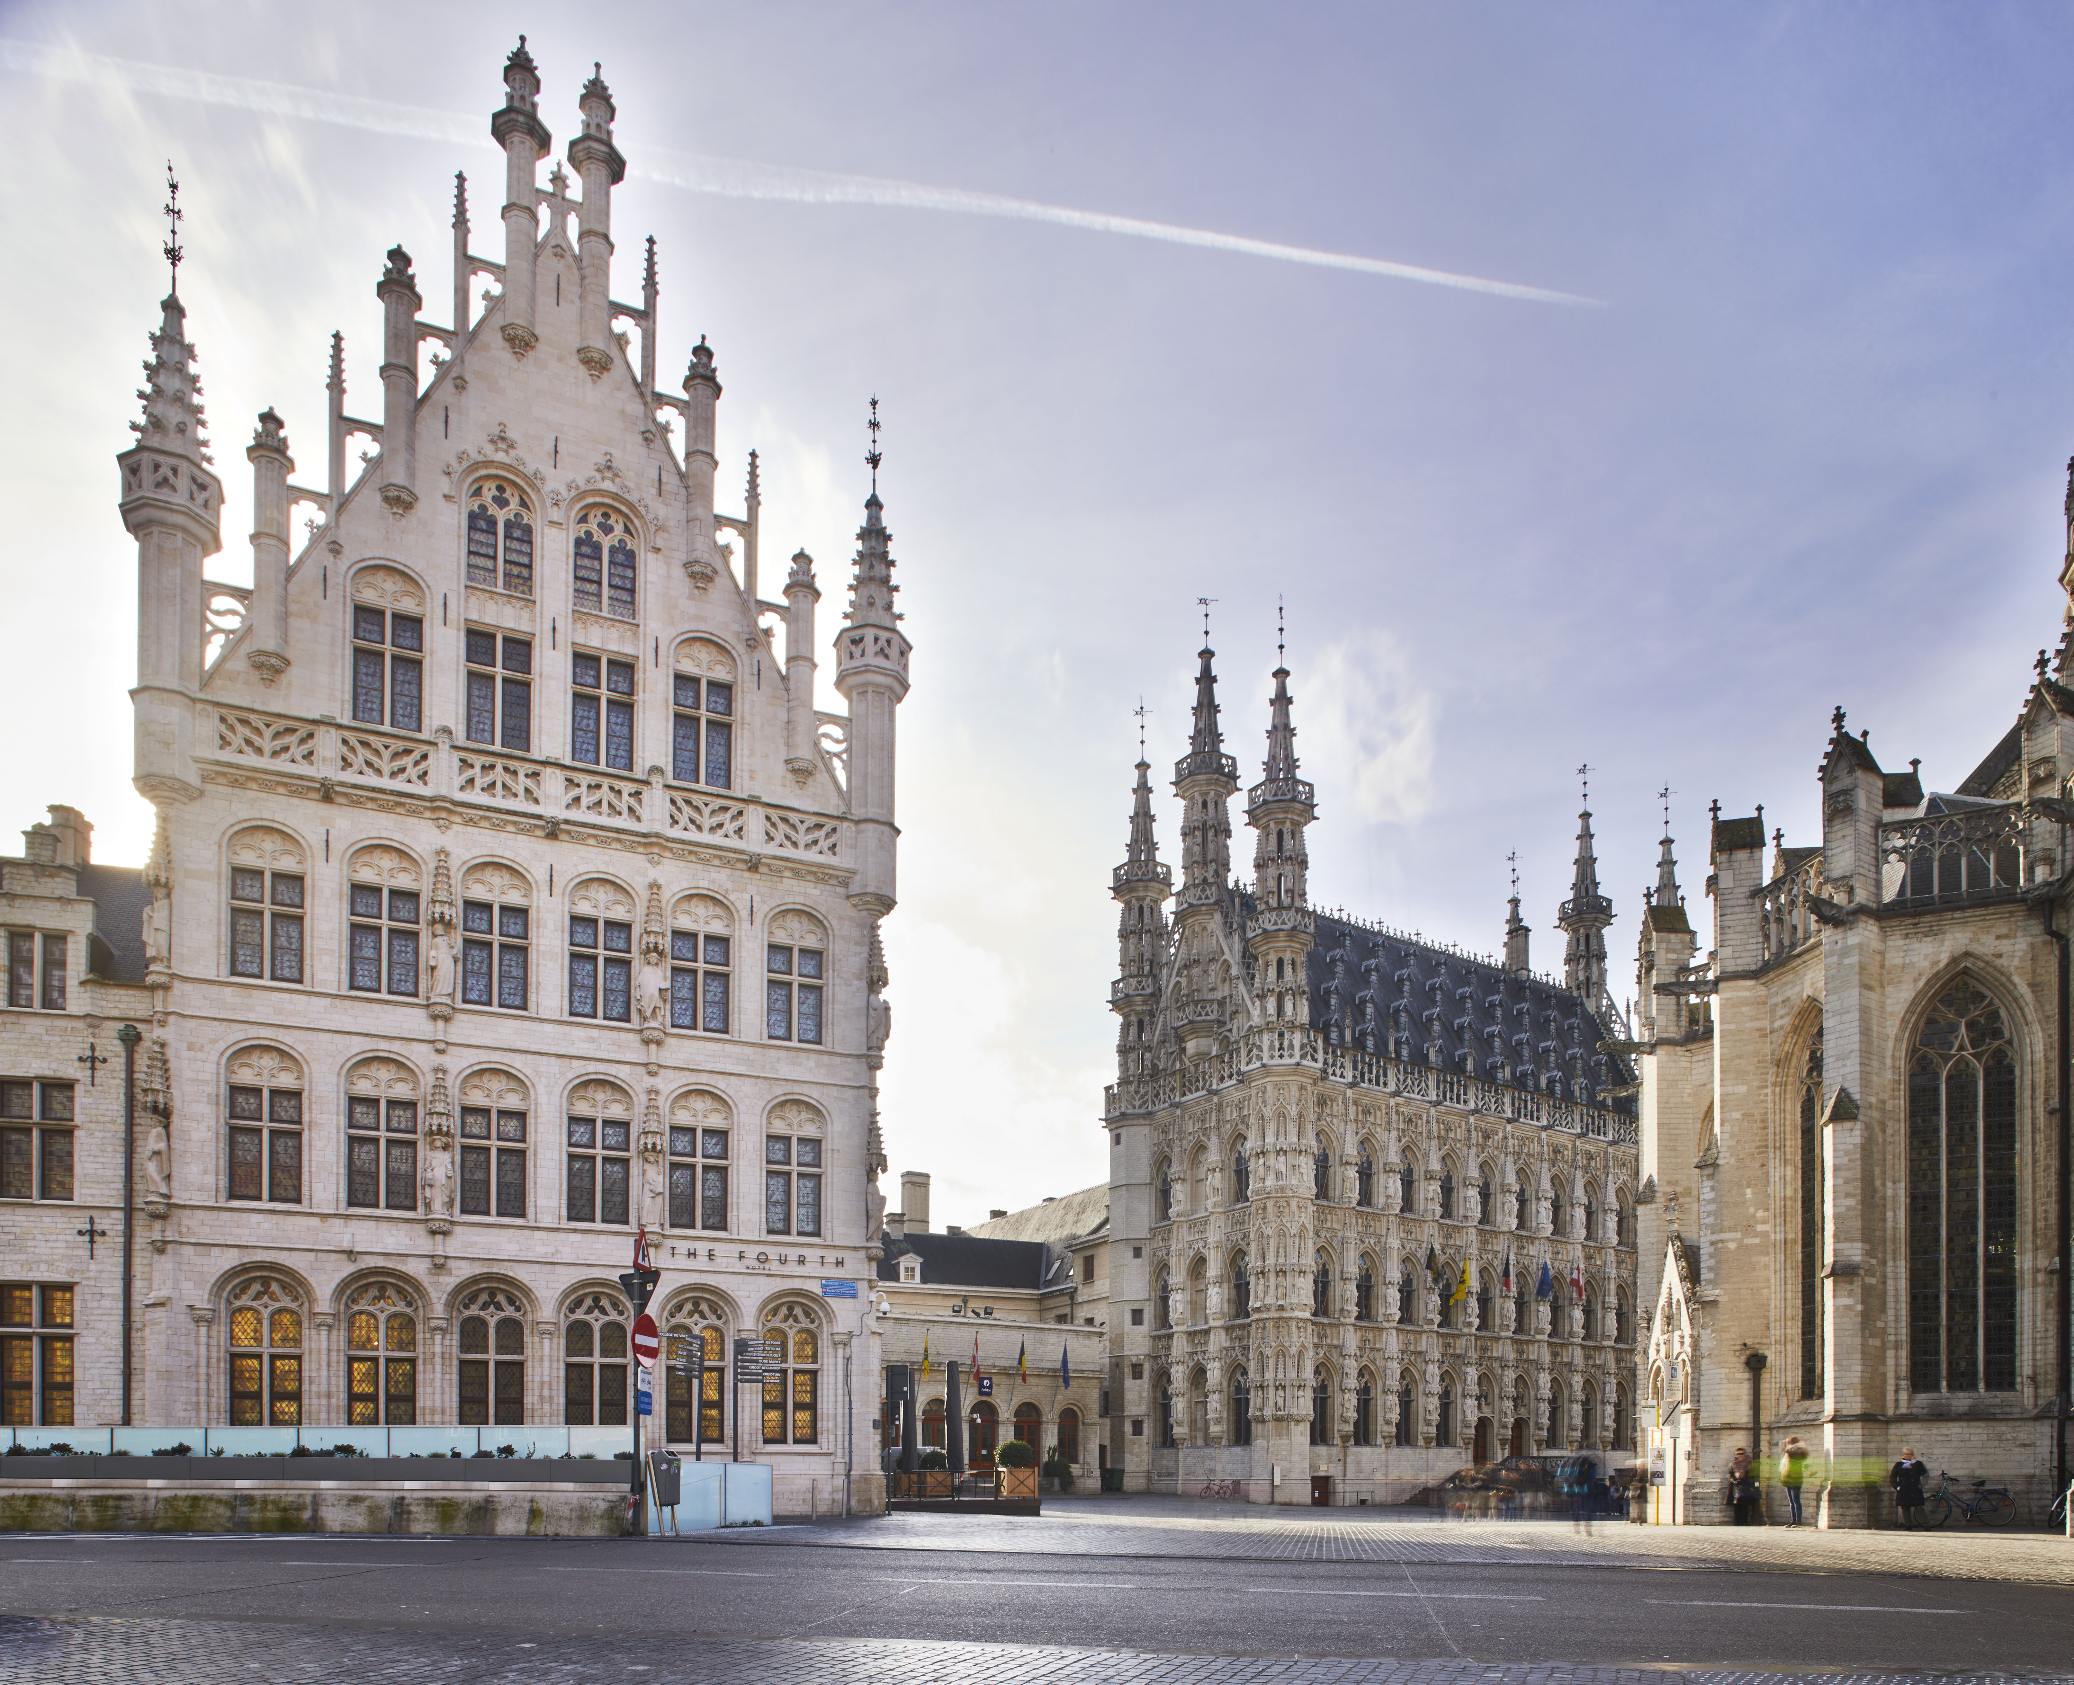
2. Leuven
Historic university town
30 min from Brussels
60,000+ students
Lively, safe, student-friendly
Tafelrond, Leuven

Slide 5
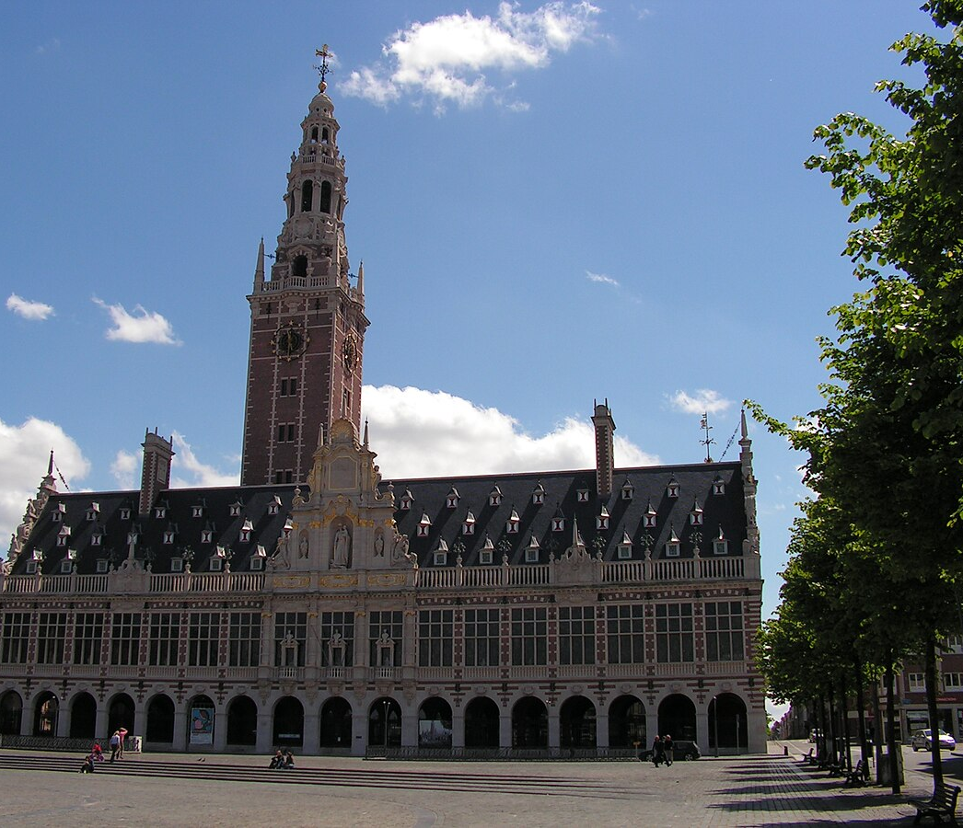
3. KU Leuven Overview
Founded in 1425
Ranked among TOP universities in Europe
Strong focus on research
International community
Leuven University Library

Slide 6
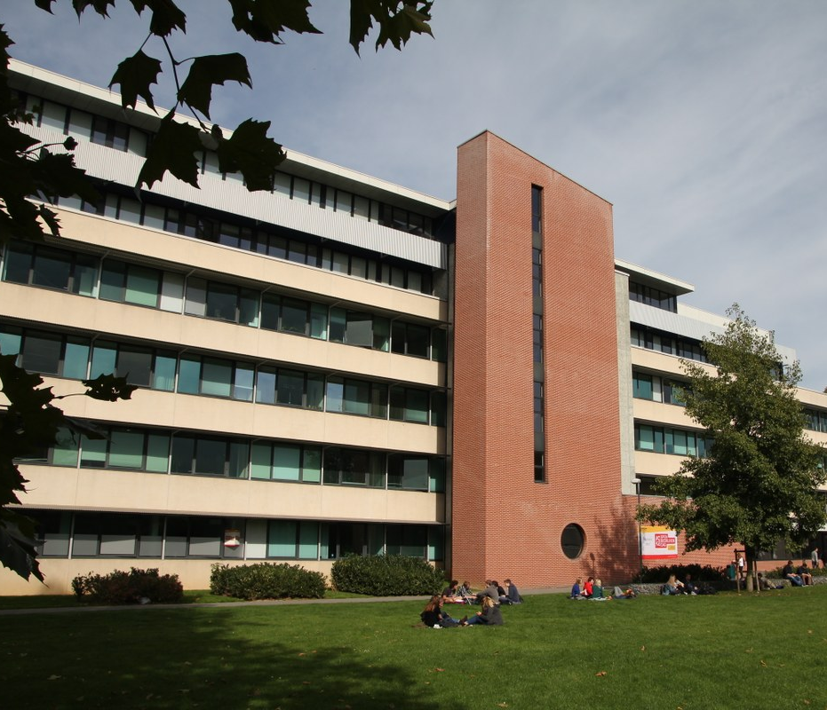
4. Computer Science at KU Leuven
Modern CS curriculum
Research labs & projects
English-taught courses
Specializations available
Department of Computer Science, KU Leuven

Slide 7
5. Relevant Courses
Software Engineering
Distributed Systems
Algorithms & Data Structures
Machine Learning / AI
Cybersecurity
Databases & Cloud

Slide 8
6. Advantages for Erasmus Students
English-speaking environment
High academic quality
Support for internationals
Great city life & culture

Slide 9
7. Costs & Practical Info
Living costs moderate
Student housing available
Good public transport
Lots of student discounts

Slide 10
8. Why KU Leuven
Perfect for CS students
International experience
Improves English
Boosts your CV

Slide 11
Thank you for your attention

Slide 12
Sources
https://www.kuleuven.be/opleidingen/programmes/master-engineering-computer-science
https://www.kuleuven.be/english/education
https://en.wikipedia.org/wiki/KU_Leuven
https://images.goway.com/production/hero/Ghent%20at%20sunset_iStock-1389624800.jpg?VersionId=L6Kxnr1x4sNLJStpbtYYkURYYSzx3zvf
https://upload.wikimedia.org/wikipedia/commons/9/92/Tafelrond_Leuven_-_385956_-_onroerenderfgoed.jpg
https://upload.wikimedia.org/wikipedia/commons/thumb/0/03/Leuven-University-Library.jpg/1200px-Leuven-University-Library.jpg
https://wms.cs.kuleuven.be/cs/english/News/news-items/new-structure-of-the-department-of-computer-science-has-been-finalised/@@images/image-1200-f04ea1cbc4cc4acf5ae7390afb6c7292.jpeg

